Slide 1


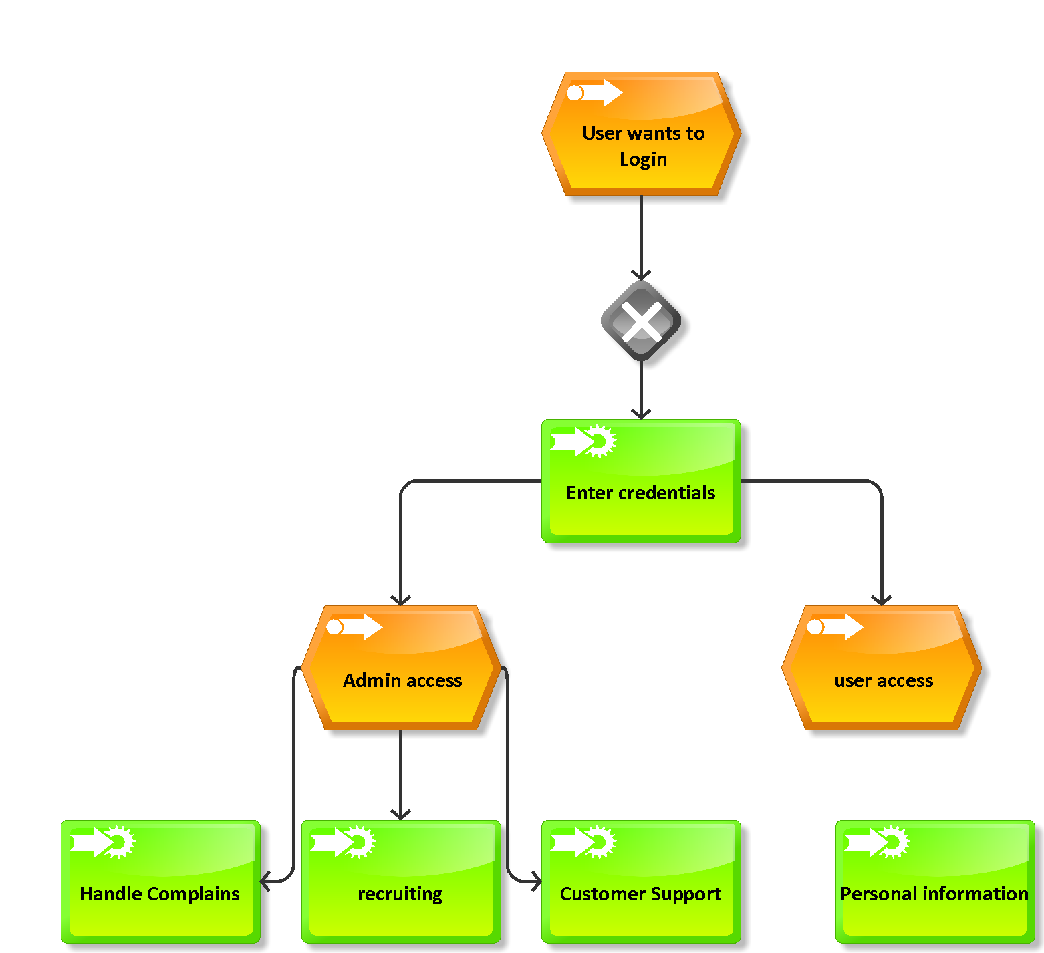
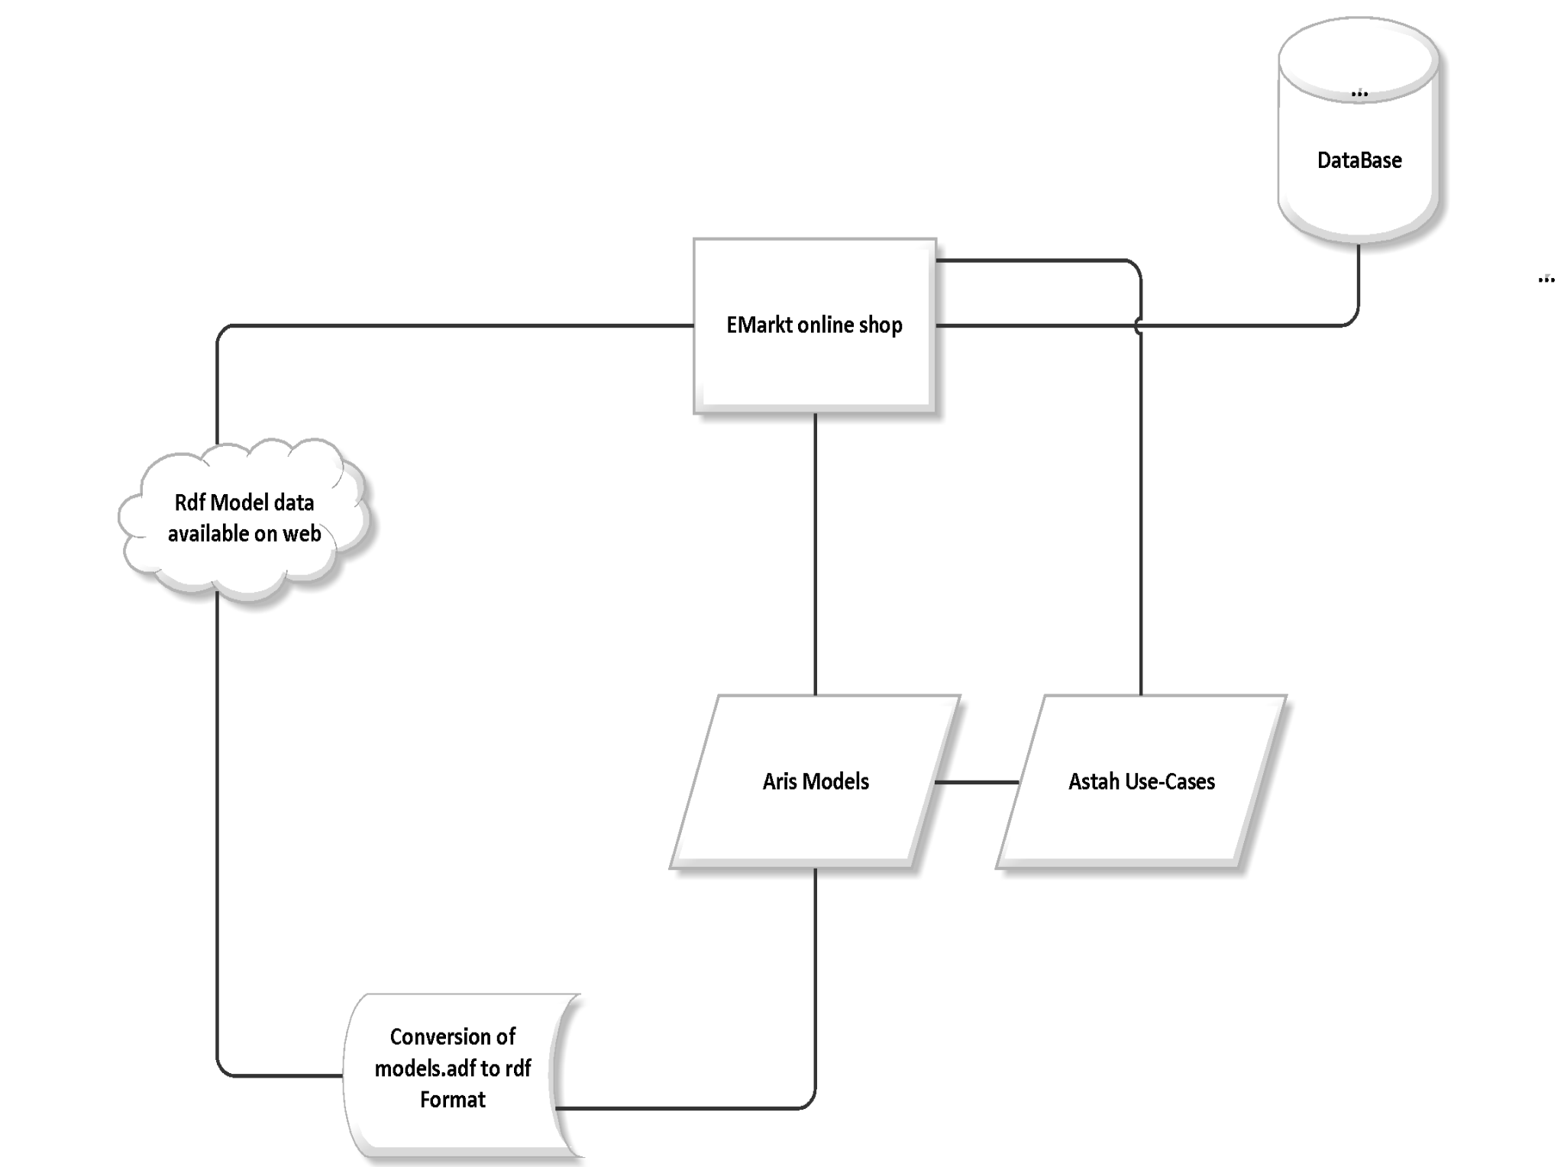



Logo/Icon
Modeling the Structure & Processes of an online-shop
Set-Up and Showcase an E-Commerce system using ARIS 9.6/Express
goto:
By:
Naurin Jamil
Dmytro Iarovyi
https://github.com/EIS-Bonn/MA-INF3232-Lab/tree/master/SomSem2014/Group%20K%20(ModellingEIS_Orlandi)
WHY ?
Consider an online shop “E-Markt”
The system analyzes different processes in the e-shop
Identifies the different use cases to cover functionalities
Builds corresponding Aris models to understand business processes
xml reports are generated from the model to give generic data
Builds RDF schema for the xml files for model data extension to re-use model data
WHAT?
Analyzed the use-cases as created in UML Designing tool ASTAH
Analyzed the ARIS Event Process Chain(EPC) Diagrams
For the EPC Diagrams, XML reports were generated
The ARIS diagrams were tested using ARIS Express testing tool
Generated RDF Files for XML reports of models
Tested the RDF file against simple Unit tests for Python
HOW ?
Open the Virtual machine
The ARIS Models are located in:
The identified Use-Cases are located in:
The script for model conversion into xml format already included in ARIS setup
The xml to RDF conversion script can be executed from :
The python code can be tested using unit tests at :
Example :Log-In Event Process Chain Diagram
Import the ARIS Models into the designer
Convert ARIS model into XML report
Give XML Report as input file for conversion into RDF Schema
Test and verify the python code and models
Steps to work :
ARCHITECTURE Diagram ‘E-Markt’
<Virtual Machine Description>
Hostname: vm-<???>
Software installed:
Installed on: EIS2 or EIS3 (?)
XAMPP Package: MySQL 5.6.16
Apache 2.4.9, PHP 5.5.11
<others>
Local Access:
OS User: eis-user
Password: <INCLUDE HERE>
Remote Access:
Partner ID: 51220xxxx Password: <INCLUDE HERE>
Help-Lines :
www.ariscommunity.com
EIS
Enterprise
Information Systems
Enterprise
Information Systems

